Slide 1
UNIT – III
Pointers: Definition and declaration and initialization of pointers. Accessing values using pointers. Accessing array elements using pointers.
Functions: Definition and declaration. Built-in functions and User-defined functions. Categories of functions with example. Pointers as function arguments, array as function argument, Call-by-value and call-by-reference. Recursion.

Slide 2
C Pointers
What is a Pointer in C?
A pointer is a derived data type that can store the address of other variables or a memory location.
Pointers allow us to access and modify the data stored at a specific memory location.
As the pointers in C store the memory addresses, their size is independent of the type of data they are pointing to.
The operator & gives the address of a variable.
The indirection or deference operator (*) to accesses the value stored at the pointer’s address.

Slide 3
Declaration of pointer in C
To declare a pointer, use the dereferencing operator(*) followed by the data type and pointer variable name.
datatype *ptr_name;
data_type - can be any valid C data types(eg: int,char,float).
The indirection operator(*) - indicates the variable is a pointer which declares a pointer.
ptr_name - Name of the pointer variable(any valid identifier).
Note: pointers can be defined to variable, functions, structures, etc.

Slide 4
How to Use Pointers?
The use of pointers in C can be divided into three steps:
Pointer Declaration
Pointer Initialization
Pointer Dereferencing

Slide 5
Pointer Declaration
A pointer declaration defines the variable that store the memory address of another variable and use deference operator(*) before the pointer variable name the but do not initialize it.
Syntax:
datatype *pointer_name;
Example:
int *ptr;
The pointer declared here will point to some random memory address as it is not initialized. Such pointers are called wild pointers.

Slide 6
2. Pointer Initialization
Pointer initialization is the process to assign some value to the pointer variable.
Use the (&) address operator to get the memory address of a variable and then store it in the pointer variable.
Example int var = 10;
int *ptr;
ptr = &var; //ptr now holds the address of var
Pointer can be declare and initialize in a single step. This method is called pointer definition as the pointer is declared and initialized at the same time.
int *ptr = &var;
Note: It is recommended that the pointers should always be initialized to value before using it. Otherwise, it may lead to number of errors.

Slide 7
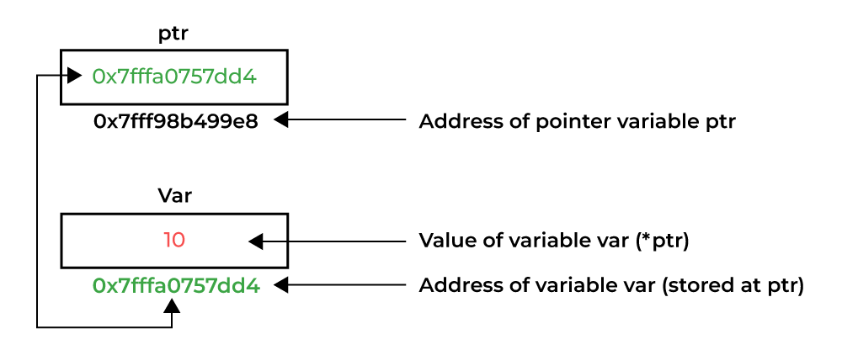
3. Pointer Dereferencing
Dereferencing a pointer is the process of accessing the value stored in the memory address specified in the pointer.
Use the same ( * ) dereferencing operator that used in the pointer declaration.

Slide 8
Memory Address
When a variable is created, a memory address is assigned to the variable.
The memory address is the location in memory where the variable is stored on the computer.
When you assign a value to the variable, that value is stored at the assigned memory address.
To access the memory address, use the reference operator (&), which gives the address where the variable is stored.

Slide 9
Creating Pointers
To get the address of a variable use the reference operator (&).
The reference operator is also known as the address of operator.
A variable myAge was defined and initialized with the value 43 .
To retrieved the address of this variable myAge use the address operator (&).
int myAge = 43;
printf("%p", &myAge); // Outputs 0x7ffe5367e044

Slide 10
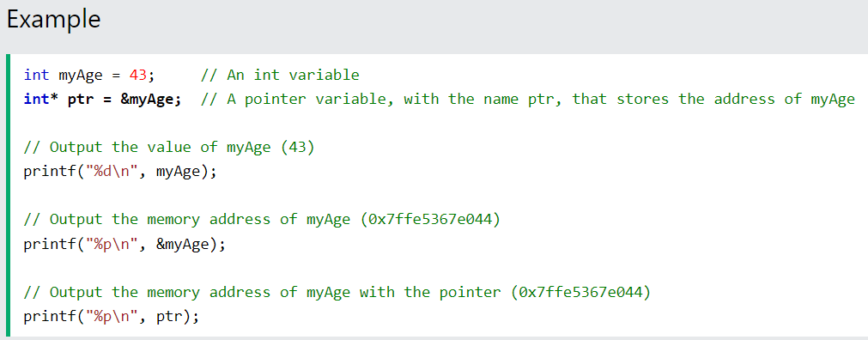

Slide 11
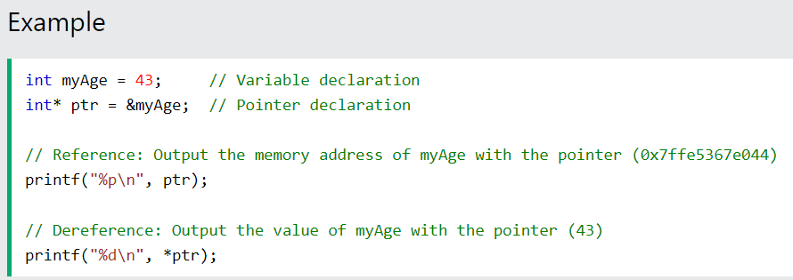
Dereference
Dereferencing a pointer is the process of accessing the value stored in the memory address specified in the pointer. Use the same (*) dereferencing operator that used in the pointer declaration.
Note: The %p format specifier to print the address in hexadecimal form.

Slide 12
Two ways to declare pointer variables
printf("%d\n", *p);
int* myNum;
or
int *myNum;
Note:
When used in declaration (int* ptr) it creates a pointer variable.
When not used in declaration, it acts as a dereference operator.

Slide 13
Variables, addresses
Memory Address | Value | Variable at this address
0x1000
0x1004 | 11 | a
0x1008 | 20 | b
0x100C
0x1010
0x1014 | 0x1004 | p1
0x1018 | 0x1008 | p2
0x101C
int a, b;
int *p1, *p2;
a = 11;
b = 20;
p1 = &a;
p2 = &b;

Slide 14
Declaring a string constant using pointers
char *s1 = “HELLO”;
‘s1’ is a pointer variable that points to a character.
The compiler will allocate space for the string “HELLO”, and copy the starting address of this space into the variable ‘s1’.
Address | 0x100 | 0x101 | 0x102 | 0x103 | 0x104 | 0x105
Contents | ‘H’ | ‘E’ | ‘L’ | ‘L’ | ‘O’ | ‘\0’
Variable | s1
Address | 0x120
Contents | 0x100

Slide 15
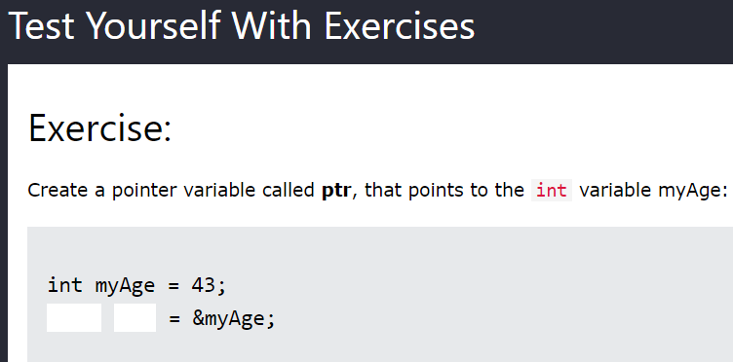

Slide 16
Pointers and Arrays
Pointers are also used to access arrays.
Ex: int myNumbers[4] = {25, 50, 75, 100} ;
An array name acts like a pointer constant.
The value of this pointer constant is the address of the first element of the array.
Eg : - myNumbers==&myNumbers[0]
Assign this address to a non-constant pointer of the same type, and then use that pointer to access the elements of the array.
Eg : - int *ptr = myNumbers;
myNumbers → gives address of first element
ptr now points to myNumbers[0]
Eg : - ptr == myNumbers == &myNumbers[0]

Slide 17
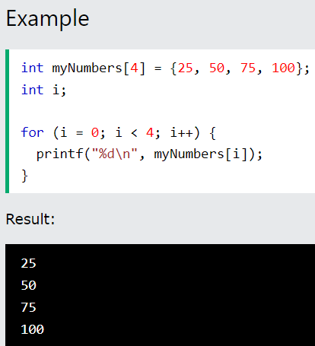
To print the elements of an array

Slide 18
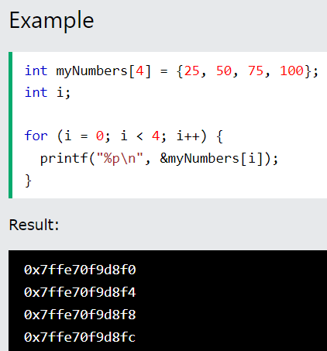
To print the memory address of each array element use address operator(&) for an array :
Note: The last number of each of the elements' memory address is different, with an addition of 4. It is because the size of an int type is typically 4 bytes.

Slide 19
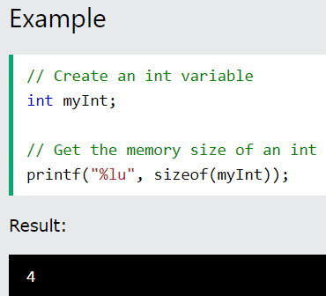
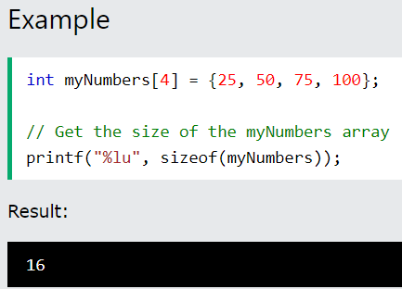
Note: The compiler reserves 4 bytes of memory for each array element, which means that the entire array takes up 16 bytes (4*4) of memory storage.

Slide 20
How Are Pointers Related to Arrays
In C, the name of an array, is actually a pointer to the first element of the array.
The memory address of the first element is the same as the name of the array address:
int myNumbers[4] = {25, 50, 75, 100};
printf("%p\n", myNumbers) //Get the memory address of the myNumbers array printf("%p\n", &myNumbers[0]); // Get the memory address of the first array element
Output:
0x7ffe70f9d8f0
0x7ffe70f9d8f0

Slide 21
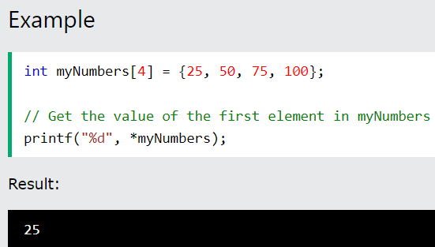
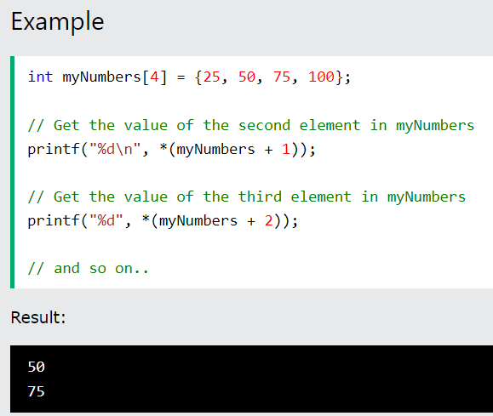
myNumbers is a pointer to the first element in myNumbers, use the * operator to access the value of the first element.
To access the rest of the elements in myNumbers, increment the pointer/array (+1, +2, etc):

Slide 22
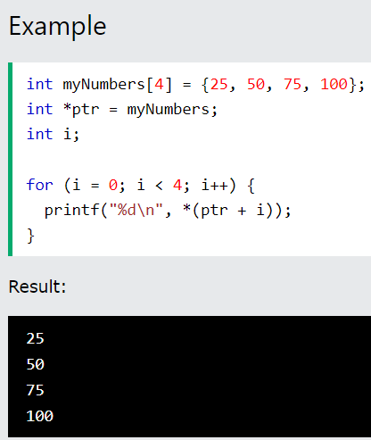
Or
using Loop can access the value of the elements of an array:

Slide 23
Change the value of array elements with pointers:
int myNumbers[4] = {25, 50, 75, 100}; // Change the value of the first element to 13 *myNumbers = 13; // Change the value of the second element to 17 *(myNumbers +1) = 17; // Get the value of the first element printf("%d\n", *myNumbers); // Get the value of the second element printf("%d\n", *(myNumbers + 1));
Output:
13 17

Slide 24
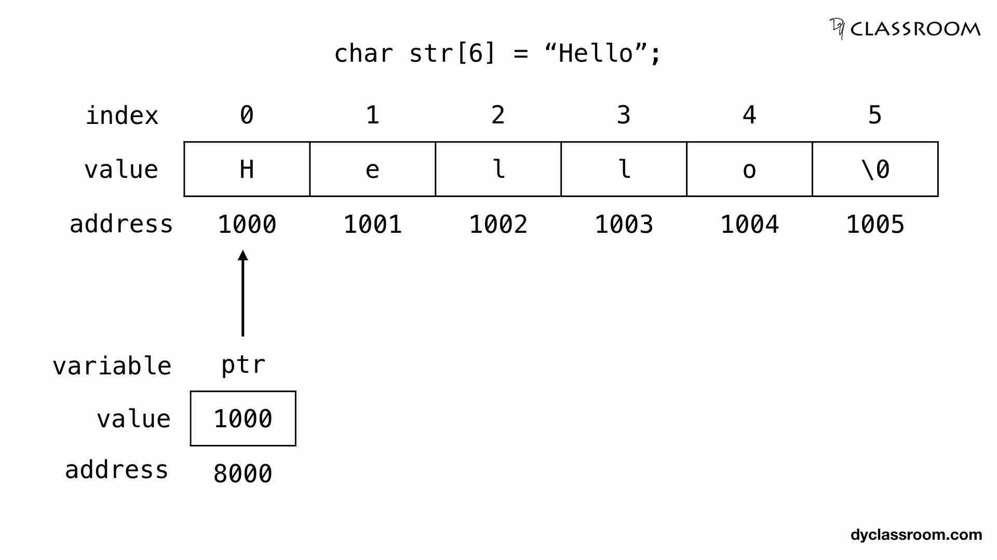
String using pointers in C
A string str using char character array of size 6.
char str[6] = "Hello";
create a character pointer ptr and store the address of the string str variable in it. This way, ptr will point at the string str.
assigning the address of the string str to the pointer ptr.
char *ptr = str;

Slide 25
Accessing string via pointer
To access and print the elements of the string we can use a loop and check for the \0 null character.
#include <stdio.h>
int main()
{
char str[6] = "Hello"; // string variable
char *ptr = str; // pointer variable
while(*ptr != '\0’)
{
printf("%c", *ptr); // print the string
ptr++; // move the ptr pointer to the next memory location
}
return 0;
}

Slide 26
Alternate way to use pointer to access array elements
int arr[10]; /* Declare array ‘arr’ of 10 integers */
int *pa; /* Declare ‘pa’ to be a pointer to a integer */
pa = arr; /* This initializes pointer ‘pa’ to point to the first element of array ‘arr’ – The name of an array evaluates to the starting address of the array */
To access the ‘i’th element of array arr, we can use the following syntax:
int b;
b = pa[i]; /* The pointer variable can be used like the array name */
Note: pa[i] is same as *(pa+i)

Slide 27
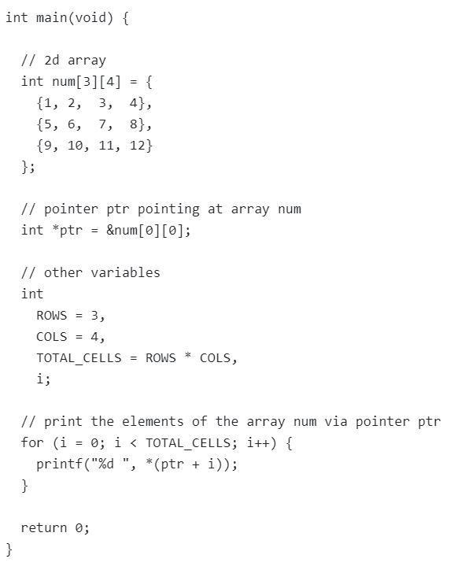
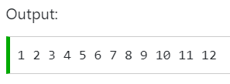
Accessing the elements of the two dimensional array via a simple pointer
In the following code,
Printing the content of the num array using for loop and by incrementing the value of ptr.
The two-dimensional array num will be saved as a continuous block in the memory.
So, if increment the value of ptr by 1 it will move to the next block in the allocated memory.

Slide 28
2D Arrays and Pointers
int arr1[3][5] = {{1,2,3,4,5},
{6,7,8,9,10},
{11,12,13,14,15}};
int (*p2)[5]; /* Declares p2 to be a pointer to an array of 5 integers */
p2 = arr1[0];
/* Giving only one dimension of ‘arr1’ evaluates to the address of the first row of array ‘arr1’ */
printf("arr1[0][0]=%d\n",p2[0][0]);
printf("arr1[2][3]=%d\n",p2[2][3]);

Slide 29
Another way to declare 2D pointers
int arr1[3][5] = {{1,2,3,4,5},
{6,7,8,9,10},
{11,12,13,14,15}};
/* Declares p2 to be a pointer to a 2D array of 3 x 5 integers */
int (*p2)[3][5];
p2 = arr1; /* Or, p2 = &arr1[0][0] */
printf("arr1[0][0]=%d\n",(*p2)[0][0]);
printf("arr1[2][3]=%d\n",(*p2)[2][3]);
printf("arr1[1][4]=%d\n",(*p2)[1][4]);

Slide 30
Pointer Arithmetic in C
The C pointer arithmetic operations are slightly different from the ones that we generally use for mathematical calculations.
These operations are:
Increment/Decrement of a Pointer
Addition of integer to a pointer
Subtraction of integer to a pointer
Subtracting two pointers of the same type
Comparison of pointers

Slide 31
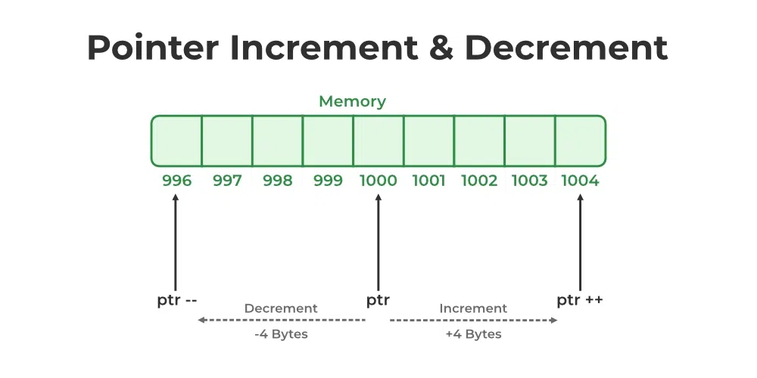
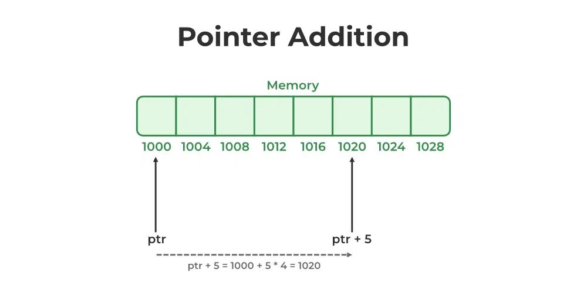
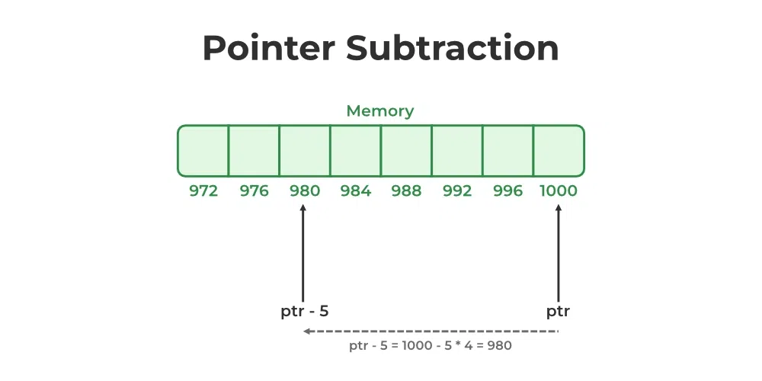

Slide 32
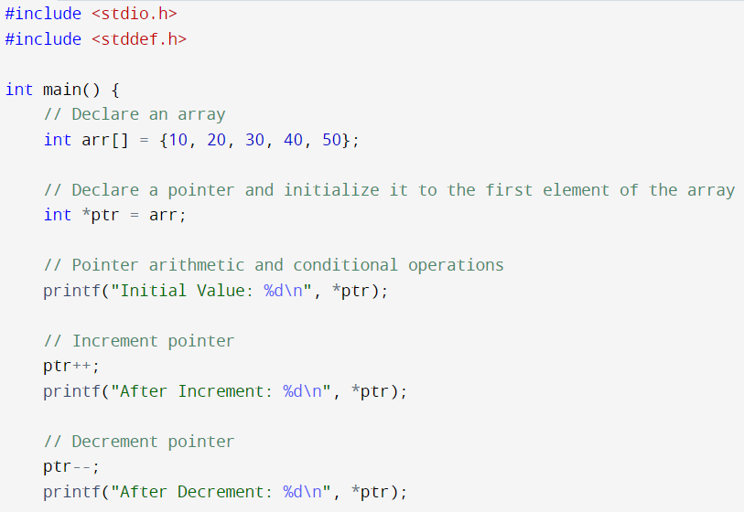

Slide 33
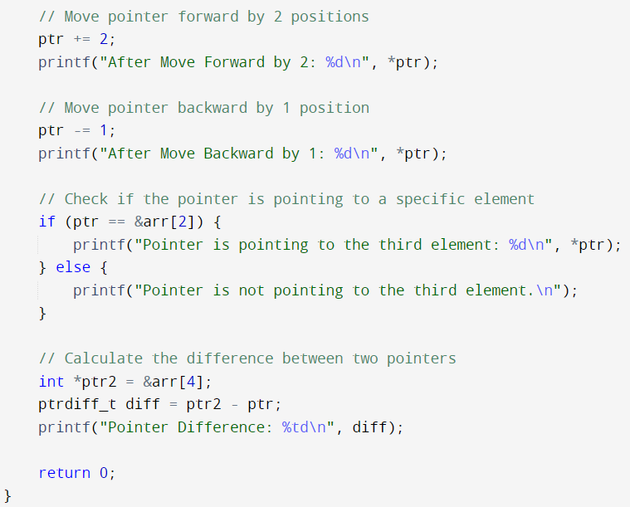
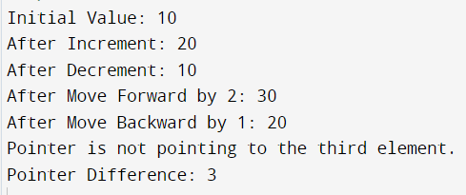

Slide 34
Advantages of Pointers are :-
Pointer provide direct access to the memory.
Pointer provides a way to return more than one value to the functions – Multiple parameters can be declared as pointers through which values are returned.
Pointers provides an alternate way to access array elements.
Used to write system software and low level code – Pointers are used to address devices in the system.

Slide 35
Disadvantages of Pointers are :-
Pointer are slower than normal variables.
Uninitialized pointer can cause segmentation fault when it is dereferenced.
If a pointer is accidentally assigned an address that points to another variable in the program, it can lead to corruption of data when we write using the pointer.
Basically, pointer bugs are difficult to handle. So, use pointer effectively and correctly.

